Slide 1
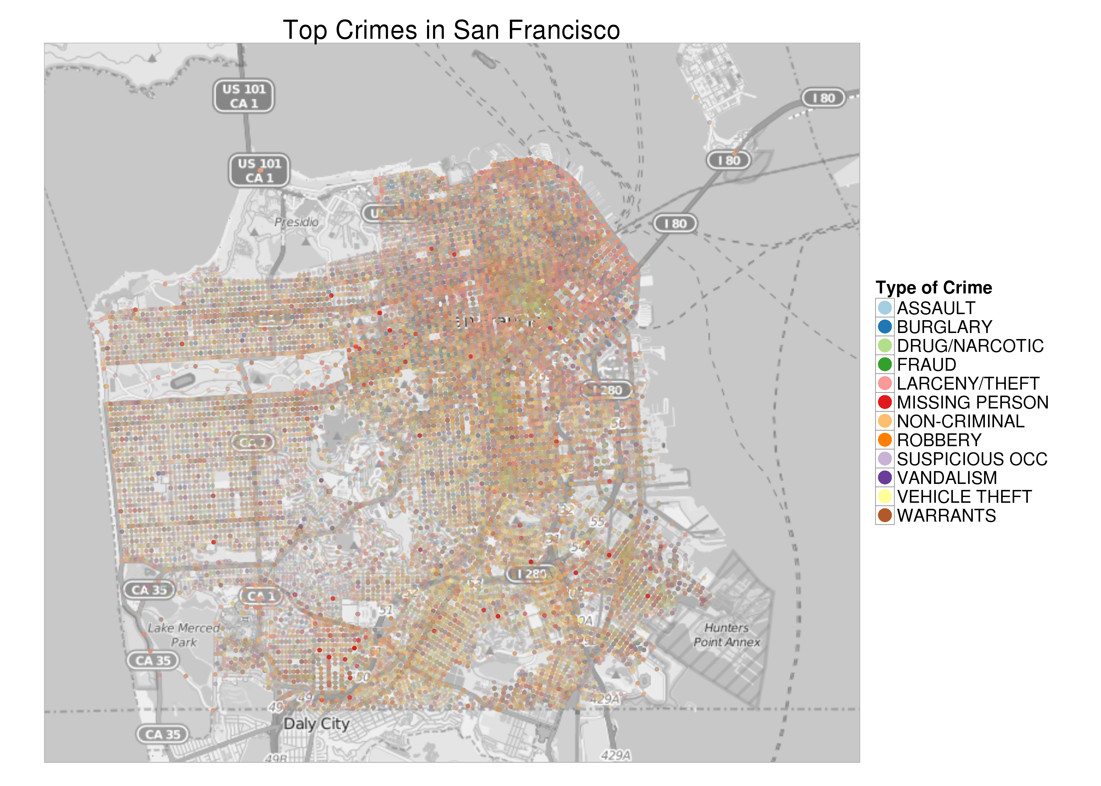
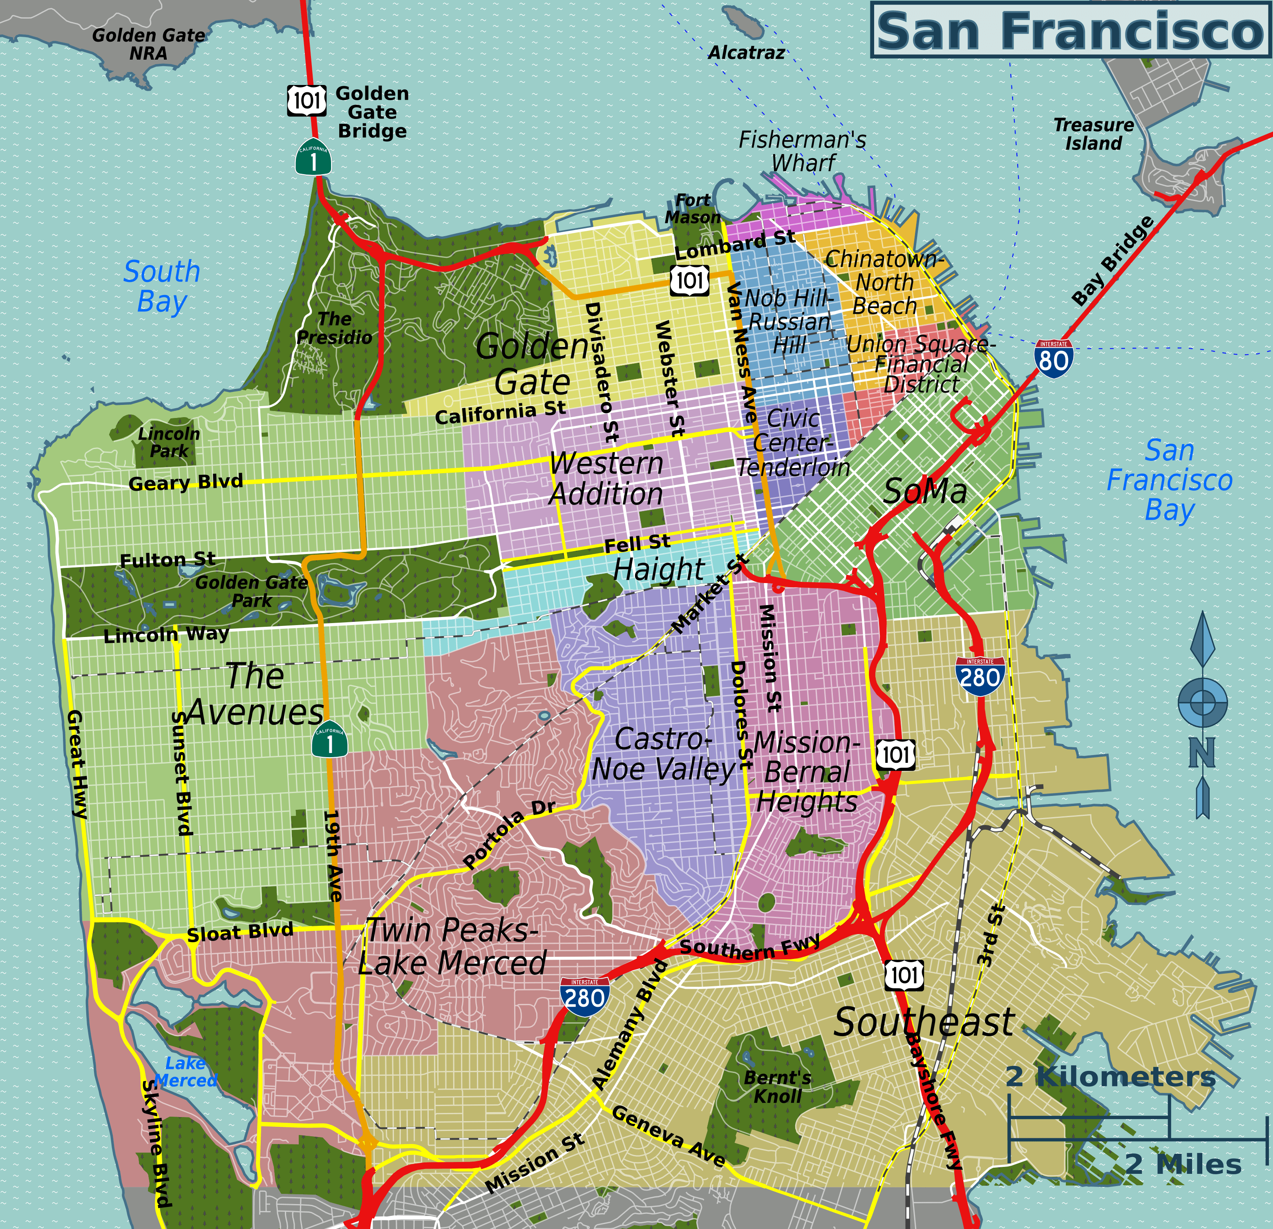
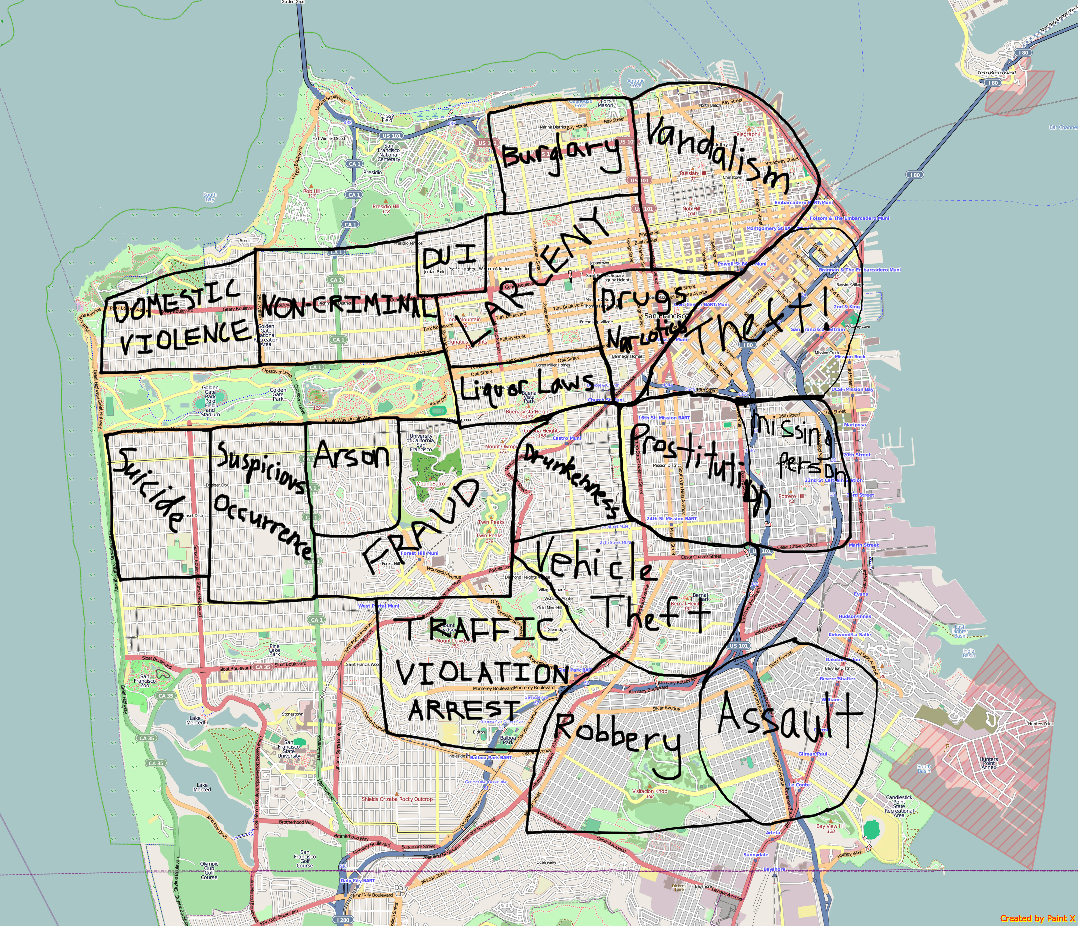
Investigating Crime Classification in San Francisco
Group Members: Anindita Mozumder James Morgan Nithin Reddy Prashant Sharma Santhosh K Jagadish Srikar Potta Stuti Nanda

Slide 2
Investigating Crime Classification in San Francisco
Group Members: Anindita Mozumder James Morgan Nithin Reddy Prashant Sharma Santosh K Jagadish Srikar Potta Stuti Nanda

Slide 3
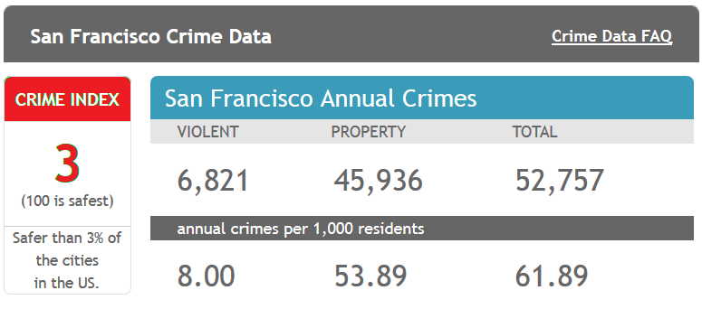
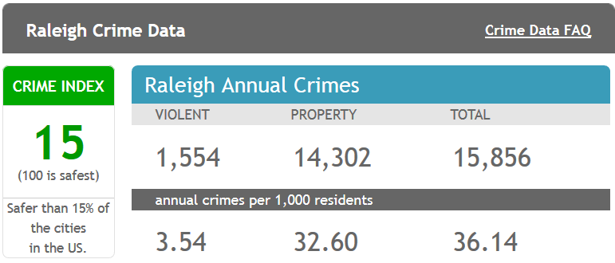
Background
From 1934 to 1963, San Francisco was infamous for housing notorious criminals
Rising wealth inequality, housing shortages responsible for increasing crime rate
The Kaggle’s dataset provides nearly 12 years of crime reports from across all of San Francisco's neighborhoods
Source: http://www.neighborhoodscout.com/ca/san-francisco/crime/

Slide 4

Objective
Given the historical crime data predict the category of crime that occurred using various classification techniques.
Comparing the the performances of various classification techniques.
Utilize skills and knowledge gained in CSC522 to
Perform EDA to understand training data
Select and implement set of classification algorithms
Validate, Evaluate classification models
Predict the Crime Category
Compare performances

Slide 5
State of the art
Microsoft Azure Library link
Off all the submissions and papers, we found the idea from Microsoft Azure ML on count measure very interesting. We have 39 classes on actual data set. A 39 vector set for each class of address attribute would provide more information that may help improve the accuracy.

Slide 6
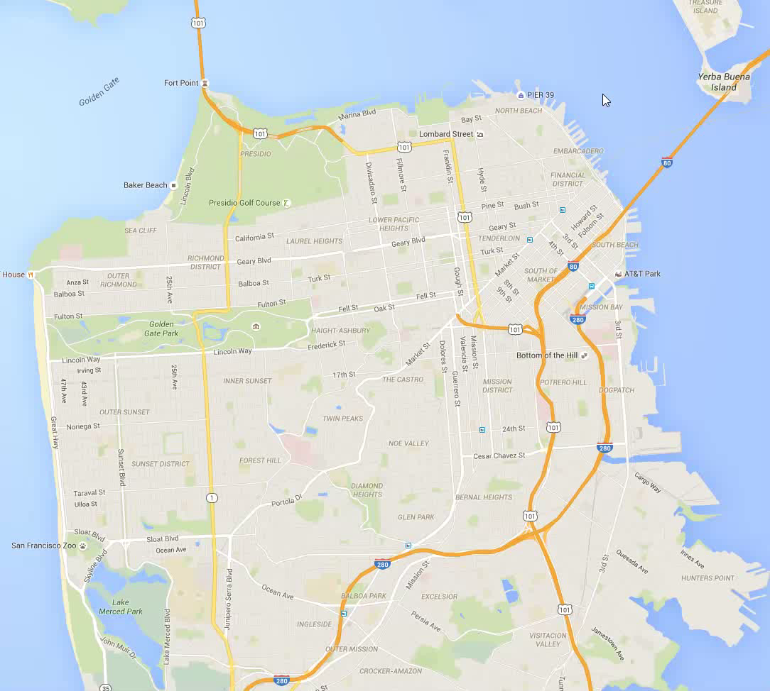
Methods
EDA
Feature Selection( Info. Gain, Chi-square for goodness of fit) test)
Evaluation and comparison
Implemented Logistic Regression, Bagging. Functions: DT, SVM, Random Forest
LOGISTIC REGRESSION | BOOT STRAPPING
Tuning parameter: Slope of each attribute (theta) | Tuning parameter: Number of decision tree

Slide 7
Results
Classifier | Accuracy | Methodology | Top Recall | Top Precision | Pros/Cons
Decision Tree | 66.06% | R/Weka | 80.92% | 67.33% | Cons- tree size very big
SVM | 63.09% | R | 75.93% | 65.85%
Random Forest | 70.833% | R/Weka | 72.37% | 80.40% | Cons- Computationally more expensive. Pros- better results than decision tree
Logistic Regression | 62.37% | R | 77.92% | 40.92%
Decision Tree with Bagging | 67.10% | R | 80.23% | 44.52%
Logistics Regression* | 58.67% | R | 89.68% | 16.19%

Slide 8
Accuracy vs Time

Slide 9
Conclusions and Future Work
Random Forest was identified based on the overall class accuracy ( 70%)
Dealing with the information loss: We have lost quite a bit of information in the attribute address. Best thing would be to find joint conditional probability distribution of each level of address attribute over all 39 classes. We would have gained much information.
Future work: Computational power can be increased by using distributed computing. Considering we have only used close to 5% of the data set. Dataset had 870,000 plus records.
Use of gradient descent is not the best method of optimization considering a huge feature space. Any optimization technique that uses automated step size selection would be good option.
Something we would do the next time: An optimal sampling method to include all 39 classes should be done considering the data set is way too right skewed.

